Slide 1
Ventera
18F PROPOSAL

Slide 2
As a concerned family member or friend, I want to know the adverse effects of a combination of drugs based off FDA Drug Incident Reports so that I may make informed decisions regarding my drug usage.
Vision

Slide 3
High-level Goals / Objectives
Provide Awareness/education around health concerns.
Give users the ability to ask informed questions to their medical practitioner.
Establish platform for additional open data to be incorporated for future enhancements and capabilities.

Slide 4
Milestones
Milestone | Date | Notes
Set up architecture | June 18, 2015
Prioritized Backlog Complete | June 19, 2015 | Initial backlog should be complete
Proposal Questions Due | June 22, 2015 | 12:00 pm
Iteration 1 | June 22, 2015
Iteration 2 | June 23, 2015
User Focus Group Complete | June 23, 2015
Iteration 3 | June 24 2015
Application Complete | June 24, 2015
Documentation Complete |  | Read-me file, Vision Doc, etc
Proposal Due | June 26, 2015

Slide 5
Release Objectives
Discovery
June 17-18
Vision
Research
Product and Release Roadmap
Release 1 – Basic Application (June 26)
Release 2 – Mobile-friendly
Web-based version of the application
application
Release 3 – TBD
Create a mobile friendly version of the application
Create an phone app
Market tool

Slide 6
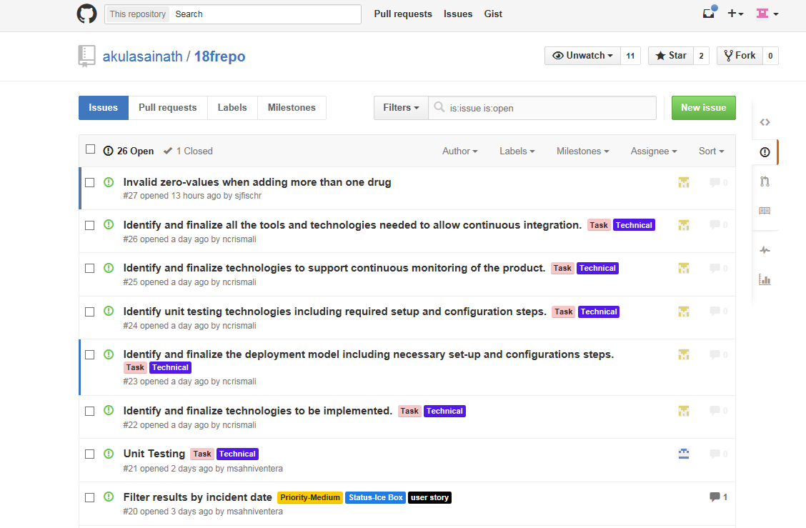
User Stories - Github

Slide 7
VDF Communication Channels

Slide 8
18F Team Communication Strategy
Process & Compliance
Requirements / Documentation
Product Manager (Swati)
PO Team
Executive Sponsor
Meeting invites / AI
Questions / feedback
Developers / Testers
End Users

Slide 9
Role Descriptions
Role Name | Description
Product Manager (Swati Khandewale) | The “Project Champion,” committed to project, solution and the delivery approach. Responsible for the project budget and implementation decisions.
End Users | Elaborated via the user personas
Product Owner Team | Interprets needs of End Users; communicates these to the team and ensures that they are reflected in the business case. Ensures that the product will enable the expected benefits. Assists with creation of the Prioritized User Story list. Provides detailed requirements to the tactical teams.

Slide 10
Role Descriptions
Role Name | Description
Development Team(s) | Build the product for the customers and stakeholders. Ensures the requirements are properly analyzed and understood. Consist of a Team Leader (Sai Akula) who ensures teams understand and meet its objectives; helps team to self-organize; helps facilitate coordination of team activity.
Process & Compliance Team Lead | Coordinates management of teams at a high-level only. Provides a suitable agile working environment for the team. Communicates project status and deliverables to Executive Sponsor.

Slide 11
Agile Kanban Approach
Ice Box
Backlog
In Progress
Done
Placeholder for story ideas
Definition of Done: Development / Deploy staging
Definition of Done:
Demo / Test / Deploy Production
Definition of Done:
Story Complete
Definition of Done: Story Elaborated and accepted by PO

